Slide 1
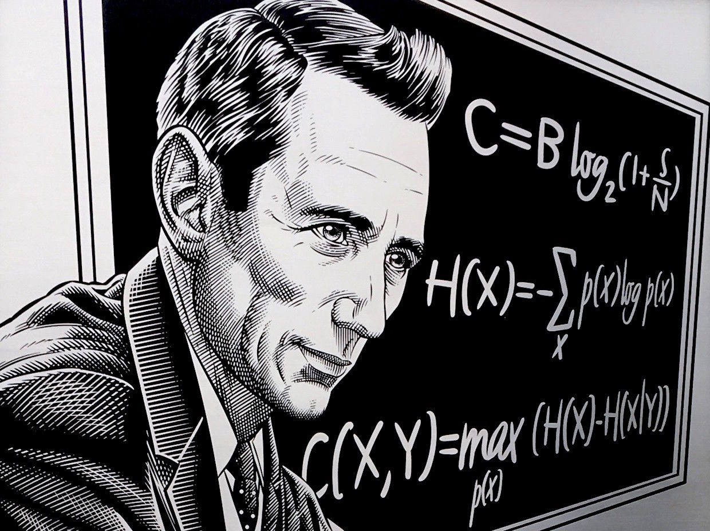
Nuggets of Shannon Information Theory
Christian Schaffner
University of Amsterdam
MCH 2022, Monday, 25 July 2022

Slide 2
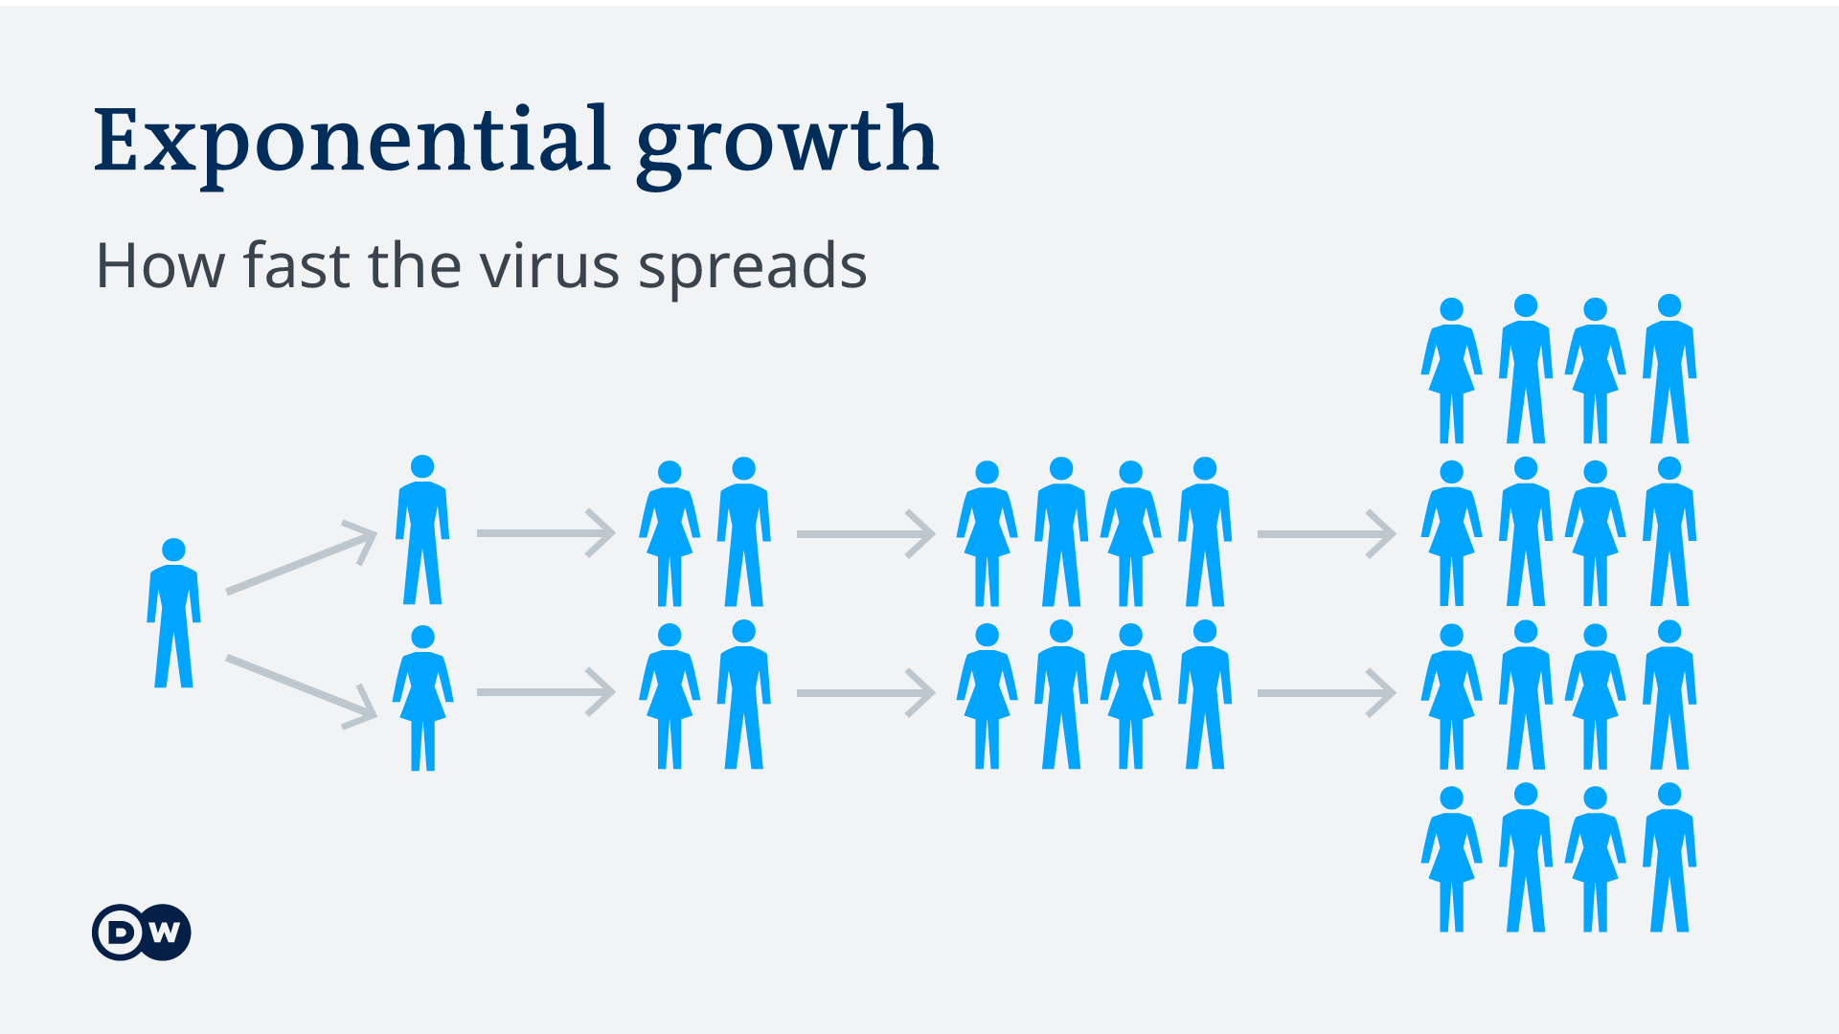
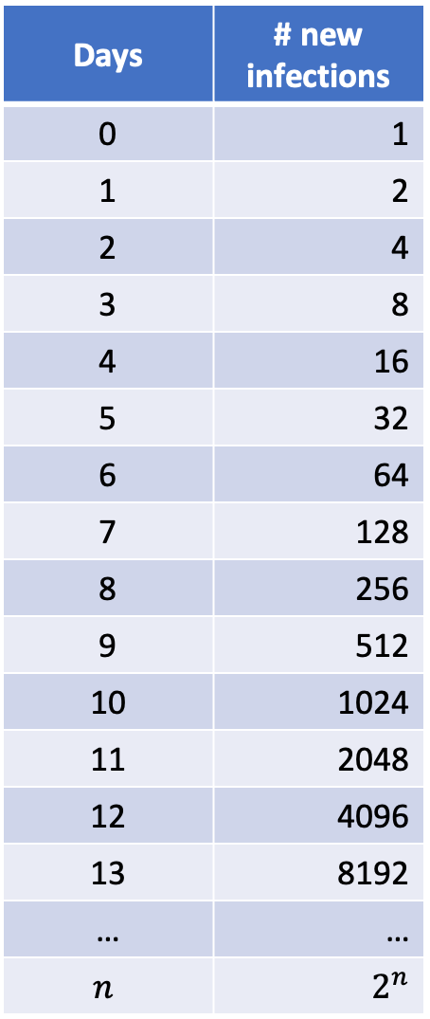
Exponential Functions
Days | # new infections
0 | 1
1 | 2
2 | 4
3 | 8
4 | 16
5 | 32
6 | 64
7 | 128
8 | 256
9 | 512
10 | 1024
11 | 2048
12 | 4096
13 | 8192
… | …
$$n$$ | $$2^{n}$$

Slide 3
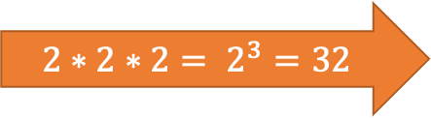
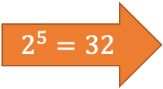
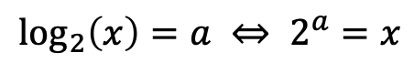
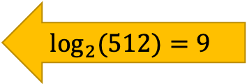
Exponentials & Logarithms
Days | # new infections
0 | 1
1 | 2
2 | 4
3 | 8
4 | 16
5 | 32
6 | 64
7 | 128
8 | 256
9 | 512
10 | 1024
11 | 2048
12 | 4096
13 | 8192
… | …
$$\log_{2}\left(x\right)=a ⇔ 2^{a}=x$$
$${2∗2∗2= 2}^{3}=32$$
Logarithms were invented for easy calculations
$$2^{5}=32$$
$$\log_{2}{(512)}=9$$

Slide 4
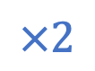
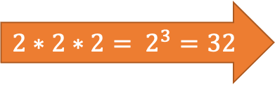
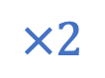
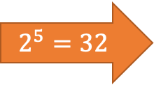
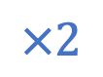
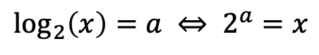
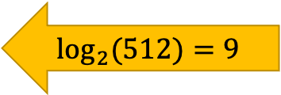
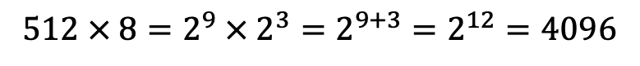
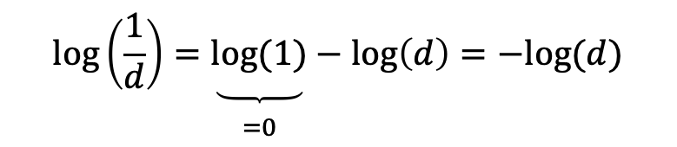
Exponentials & Logarithms
Days | # new infections
0 | 1
1 | 2
2 | 4
3 | 8
4 | 16
5 | 32
6 | 64
7 | 128
8 | 256
9 | 512
10 | 1024
11 | 2048
12 | 4096
13 | 8192
… | …
+1
$$×2$$
+1
$$×2$$
$$\log_{2}\left(x\right)=a ⇔ 2^{a}=x$$
+1
$$×2$$
$${2∗2∗2= 2}^{3}=32$$
$$\log\left(2^{x}\right)=\log_{2}\left(2^{x}\right)=x$$
Logarithms were invented for easy calculations
They translate multiplications into additions
$$2^{5}=32$$
$$512 × 8=2^{9} × 2^{3}=2^{9+3}=2^{12}=4096$$
$$2^{a}×2^{b}=2^{a+b}$$
$$\log_{2}{(512)}=9$$
$$\log\left(512 × 8\right)=\log\left(512\right)+\log\left(8\right)=9+3=12=log⁡(4096)$$
$$\log\left(c×d\right)=\log\left(c\right)+\log\left(d\right)$$
$$\log\left(\frac{1}{d}\right)=\underset{\begin{aligned} \\ =0\end{aligned}}{\underbrace{log⁡(1)}}−\log\left(d\right)=−log⁡(d)$$

Slide 5
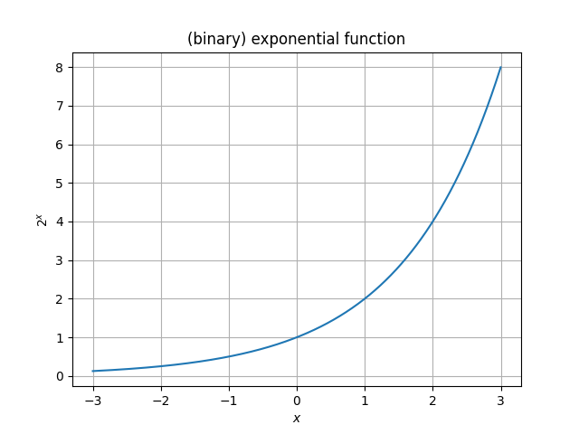
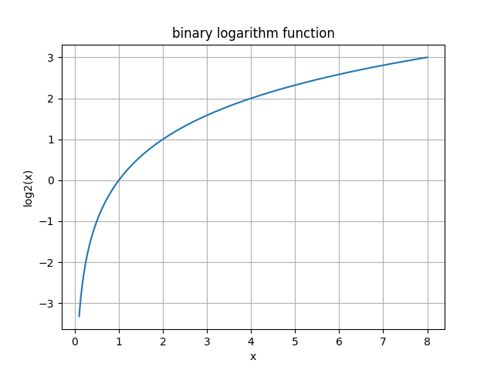
Exponentials & Logarithms
Days | # new infections
0 | 1
1 | 2
2 | 4
3 | 8
4 | 16
5 | 32
6 | 64
7 | 128
8 | 256
9 | 512
10 | 1024
11 | 2048
12 | 4096
13 | 8192
… | …
+1
$$×2$$
+1
$$×2$$
+1
$$×2$$
$${2∗2∗2= 2}^{3}=32$$
$$2^{5}=32$$
$$\log_{2}{(512)}=9$$

Slide 6
What will you Learn from this Talk?
Logarithms
Shannon Entropy
Data Compression
Error Correction

Slide 7
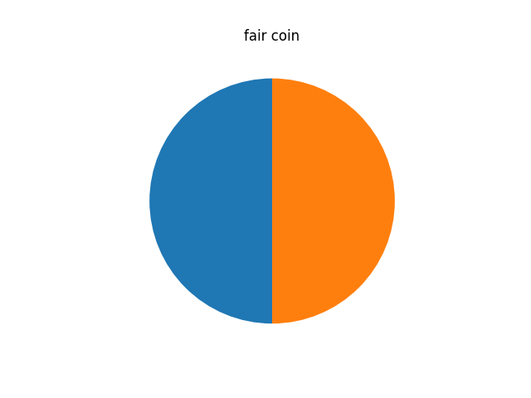
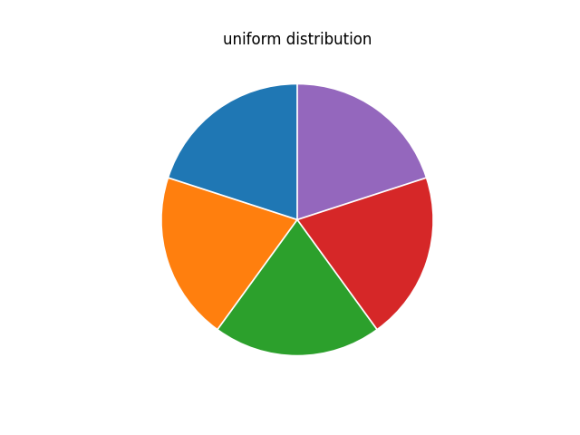
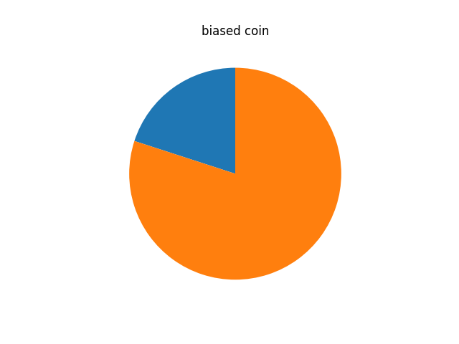
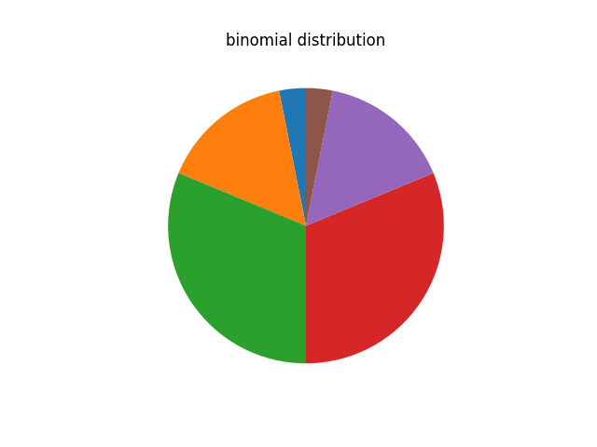
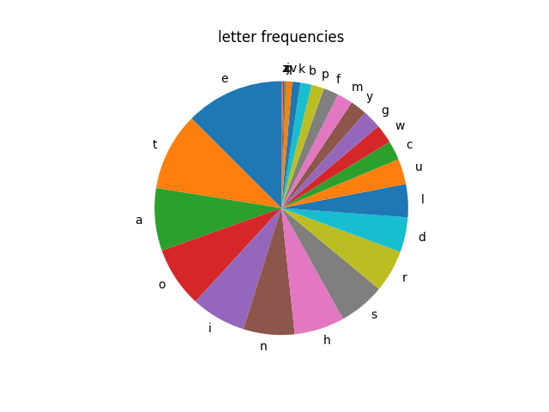
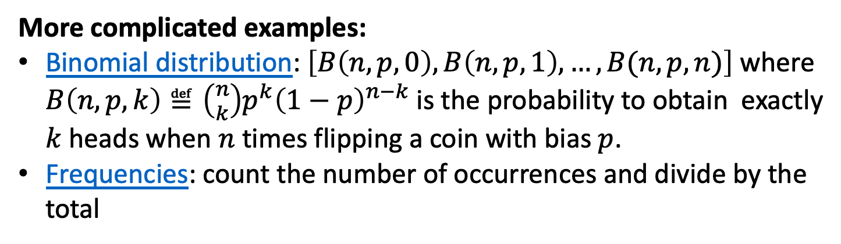
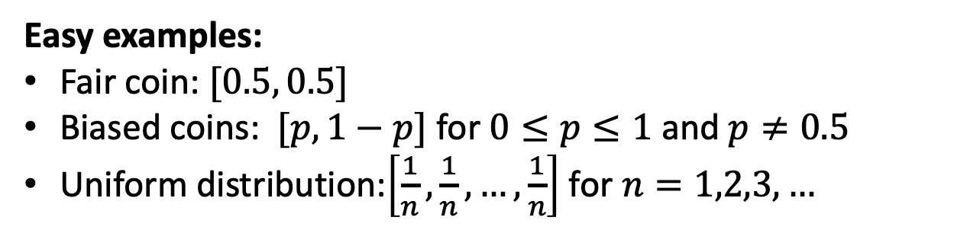
(Discrete) Probability Distributions
Definition: A list of non-negative numbers that sum to 1.
Easy examples:
Fair coin: $[0.5, 0.5]$
Biased coins: $[p, 1−p]$ for $0≤p≤1$ and $p≠0.5$
Uniform distribution:$\left[\frac{1}{n},\frac{1}{n}, …,\frac{1}{n}\right]$ for $n=1,2,3,…$
More complicated examples:
Binomial distribution: $\left[B\left(n,p,0\right),B\left(n,p,1\right), …, B(n,p,n)\right]$ where $B\left(n,p,k\right)≝\left({n \atop k}\right)p^{k}{\left(1−p\right)}^{n−k}$ is the probability to obtain exactly $k$ heads when $n$ times flipping a coin with bias $p$.
Frequencies: count the number of occurrences and divide by the total

Slide 8


Sampling from Probability Distributions
Definition: A list of non-negative numbers that sum to 1.
Easy examples:
Explain how to sample from a given distribution by aligning the probabilities, throwing a random float between [0,1) and see in which interval it ends up.

Slide 9
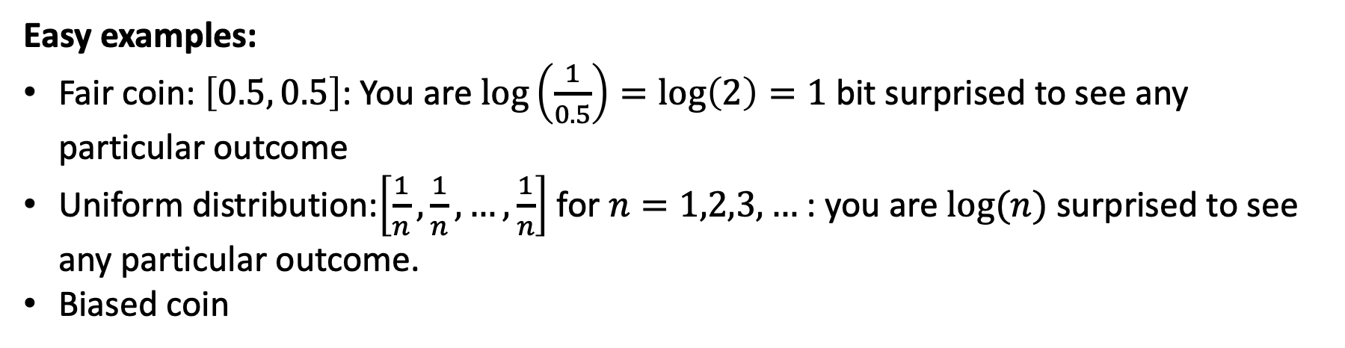
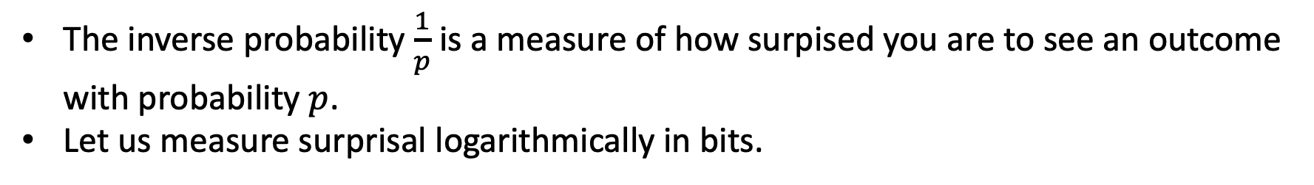
Surprisal: 😳 🫢 😯 😲 😱 🤯
The inverse probability $\frac{1}{p}$ is a measure of how surpised you are to see an outcome with probability $p$.
Let us measure surprisal logarithmically in bits.
Easy examples:
Fair coin: $\left[0.5, 0.5\right]$: You are $log\left(\frac{1}{0.5}\right)=log\left(2\right)=1$ bit surprised to see any particular outcome
Uniform distribution:$\left[\frac{1}{n},\frac{1}{n}, …,\frac{1}{n}\right]$ for $n=1,2,3,…$ : you are $log⁡(n)$ surprised to see any particular outcome.
Biased coin

Slide 10
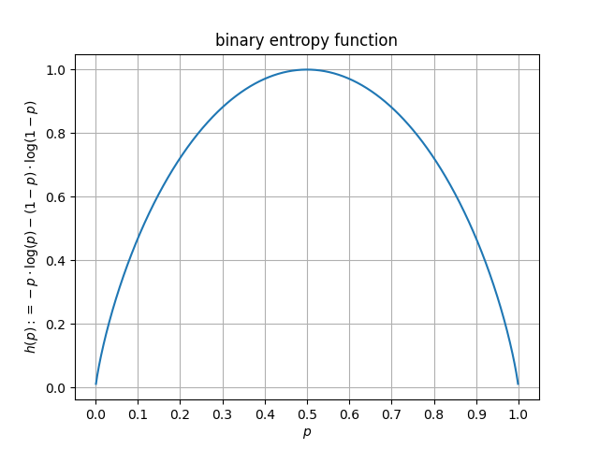
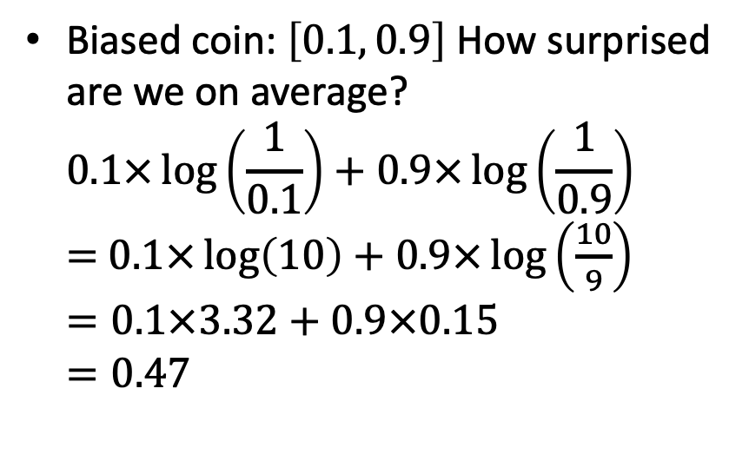
Average Surprisal
The inverse probability $\frac{1}{p}$ is a measure of how surpised you are to see an outcome with probability $p$.
Let us measure surprisal logarithmically in bits.
Biased coin: $\left[0.1, 0.9\right]$ How surprised are we on average? $0.1×\log\left(\frac{1}{0.1}\right)+0.9×\log\left(\frac{1}{0.9}\right)$ $=$ $0.1×\log\left(10\right)+0.9×\log\left(\frac{10}{9}\right)$ $=0.1×3.32+0.9×0.15$ $=0.47$

Slide 11
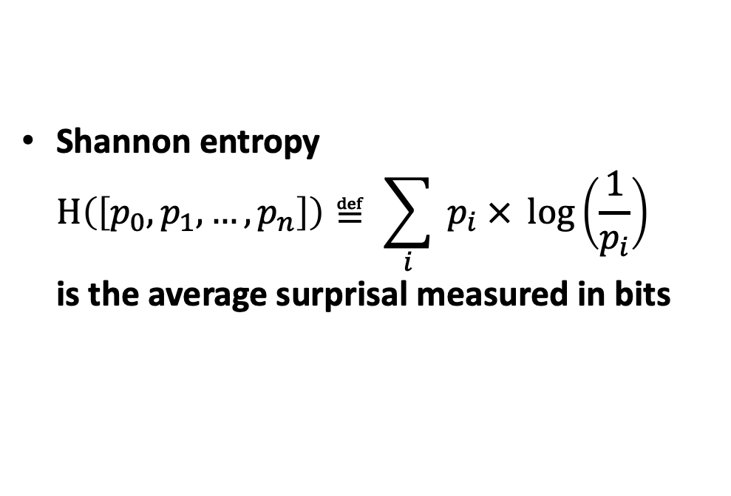
Average Surprisal = Shannon Entropy
The inverse probability $\frac{1}{p}$ is a measure of how surpised you are to see an outcome with probability $p$.
Let us measure surprisal logarithmically in bits.
Shannon entropy $H\left(\left[p_{0}, p_{1}, …, p_{n}\right]\right)≝ \sum_{i}{{ p}_{i} × \log\left(\frac{1}{p_{i}}\right)}$ is the average surprisal measured in bits

Slide 12
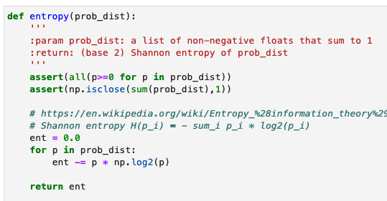
Average Surprisal = Shannon Entropy
The inverse probability $\frac{1}{p}$ is a measure of how surpised you are to see an outcome with probability $p$.
Let us measure surprisal logarithmically in bits.
Shannon entropy $H\left(\left[p_{0}, p_{1}, …, p_{n}\right]\right)≝ \sum_{i}{{ p}_{i} × \log\left(\frac{1}{p_{i}}\right)}$ is the average surprisal measured in bits

Slide 13
What will you Learn from this Talk?
Logarithms
Shannon Entropy
Data Compression
Error Correction

Slide 14


Data Compression
01010001…
a e f t t s r l o p q z d

Slide 15




Data Compression
data
data
L bits
How much “information” is contained in the data?
compress it into minimal number of L bits (per source symbol)
so that data can still be recovered perfectly
⇒ average information content is L bits per symbol
Shannon: L ≈ H( data distribution )

Slide 16
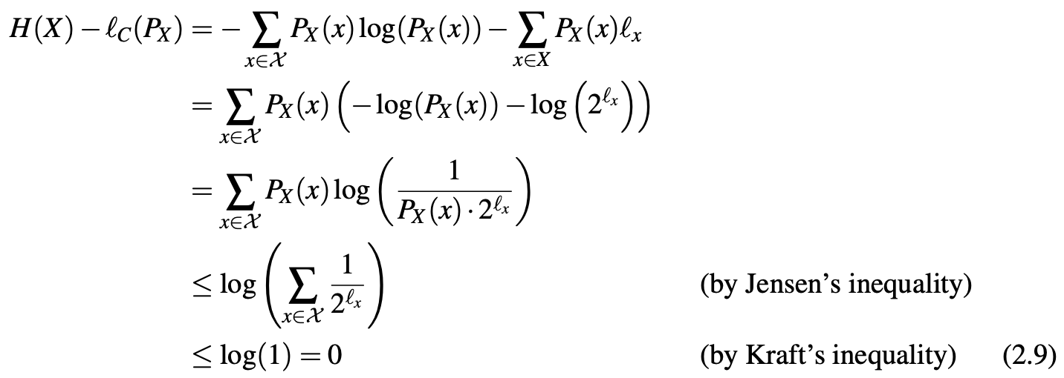
Proof: L >= H( data distribution )
Shannon: L ≈ H( data distribution )
We want to prove that at least H(dist) bits per source symbol are required no matter what compression scheme is used.
qed

Slide 17
Proof: L <= H( data distribution )
Shannon: L ≈ H( data distribution )
We give a compression method that uses H(dist) bits per symbol.
Huffman coding (by example):
Combine the two nodes with smallest probability into new one with combined weight
Codeword is given by route from root to leaf
symbol | Code word | probability
a | 10 | 0.25
b | 00 | 0.25
c | 01 | 0.2
d | 110 | 0.15
e | 111 | 0.15
0
0
0.45
0
1
1
0
0.55
1
0.3
1
1

Slide 18
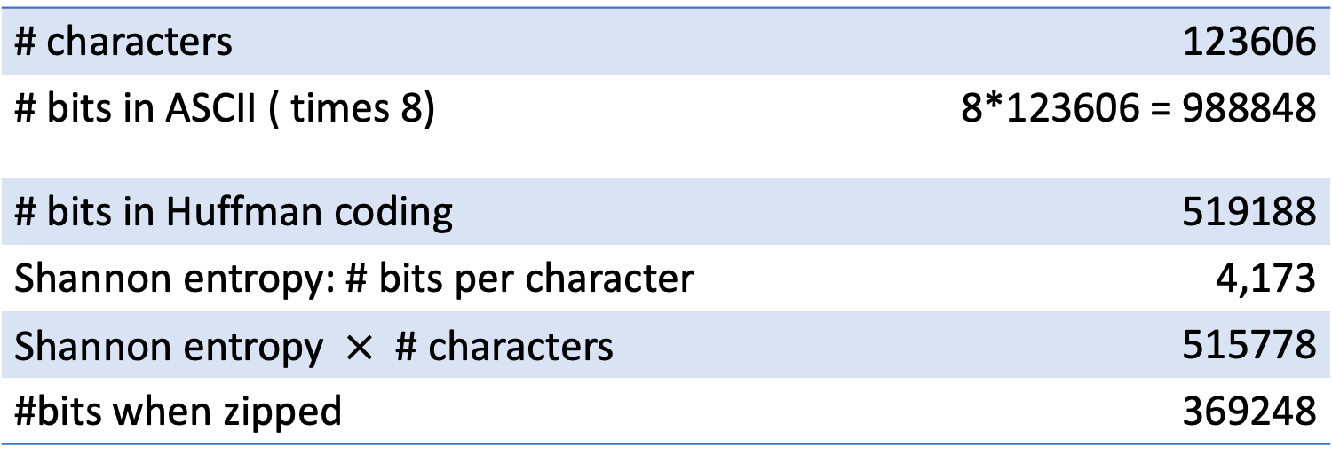
Proof: L <= H( data distribution )
Shannon: L ≈ H( data distribution )
We give a compression method that uses H(dist) bits per symbol.
Experiment: Alice’s adventures in Wonderland
# characters | 123606
# bits in ASCII ( times 8) | 8*123606 = 988848
# bits in Huffman coding | 519188
Shannon entropy: # bits per character | 4,173
Shannon entropy $×$ # characters | 515778
#bits when zipped | 369248

